Slide 1

Where can you find your MindTap eBook Access code
A : if you purchased E-version textbook access code standalone, you shall receive an access code through email
( follow this guideline to register your code and gain 12-month access to eBook plus online learning resources)
B: if you purchased a print book/hard copy , an access code is attached with print book (you can gain free access to MindTap online resources for maximum 12 months)

Slide 2
Your MindTap Course Key
Your class | Your MindTap Class Key
BBAZ16601 Introduction to Business Analytics_Fall 2021_Section 1 | MTPP-9BJQ-B0H6
BBAZ16601 Introduction to Business Analytics_Fall 2021_Section 2 | MTPQ-X5JQ-2WJW

Slide 3
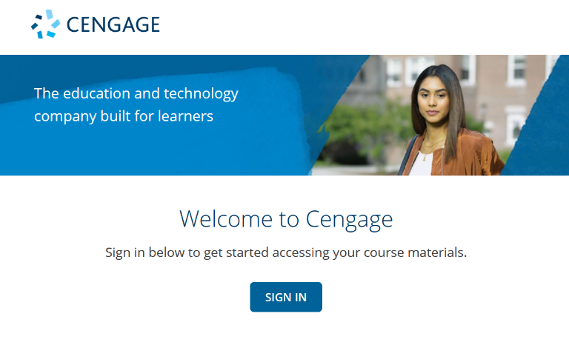
Let’s Start
Go to https://student.cengage.com/ . Click “SIGN IN”.

Slide 4
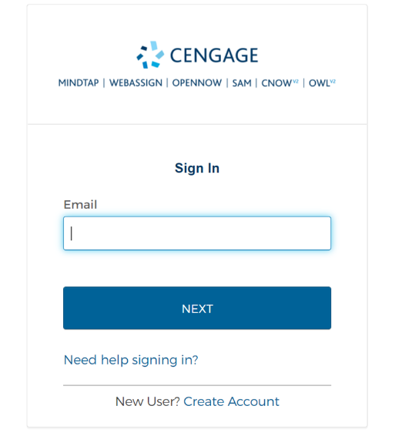
Log In to Your Account
2a. Already have a Cengage Account? Log in with your email. (Go to Step 10)
2b. New to Cengage? Click “Create Account” to register. (Go to Step 3)
2a
2b

Slide 5
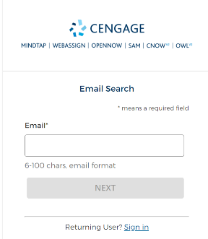
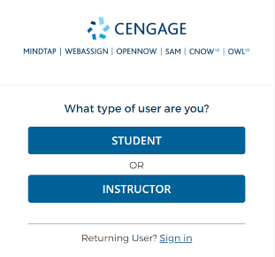
Create Cengage Account
Select “STUDENT”.
Enter your email.
B
Important: You must use a valid email address for account verification.
(使用你的MUST學生郵箱注冊）

Slide 6
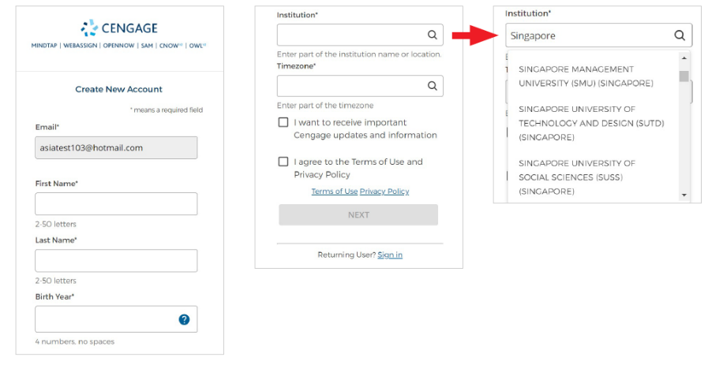
Complete the Registration
Fill in your personal information and select your institution.
Note: For institution selection, type the name of your institution and select from the dropdown list.
First name and Last name， 不要輸入中文字體，請輸拼音全名， 避免亂碼出現

Slide 7
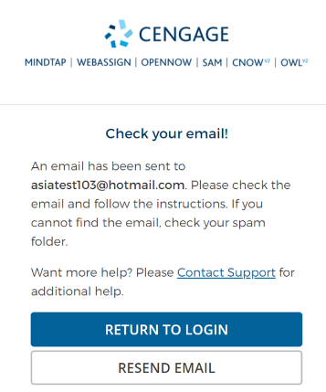
Check Your email
Open the ‘Welcome to Cengage’ email that was sent to your email address.

Slide 8

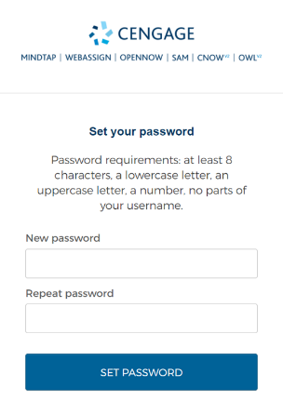
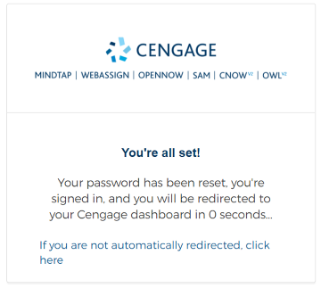
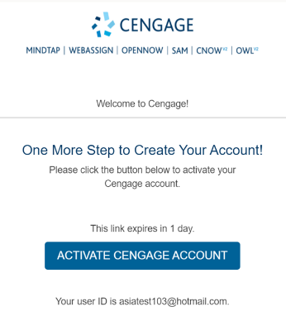
Activate Cengage Account
Click “ACTIVATE CENGAGE ACCOUNT” on the email.
Set your password.
You will be redirected to your Cengage dashboard.

Slide 9
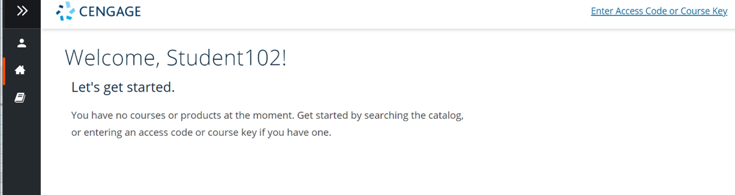
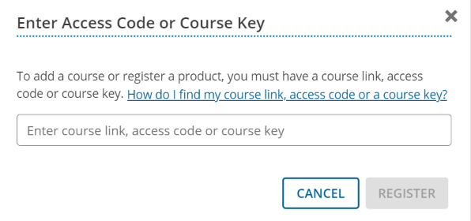
Enter Access Code
This is your Cengage Dashboard. Click “Enter Access Code or Course Key”.
Enter access code and click “REGISTER”.

Slide 10
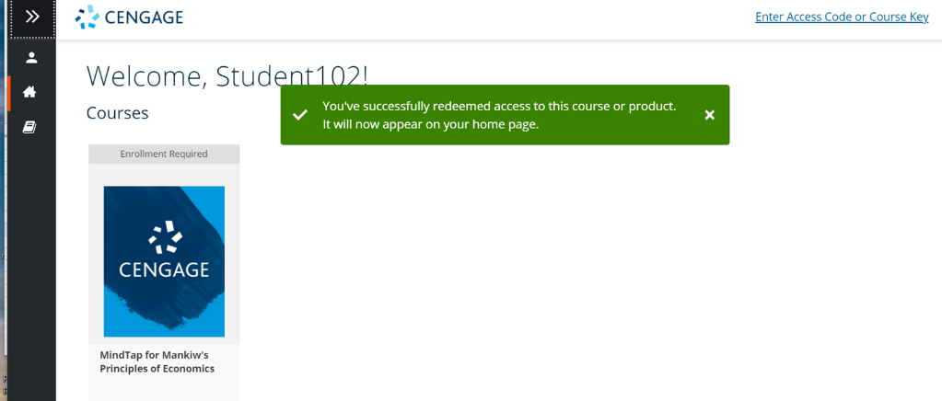
Enter Course Key
Your courseware appears on your home page. Next you need to enroll in this course. Click on it to enroll.

Slide 11
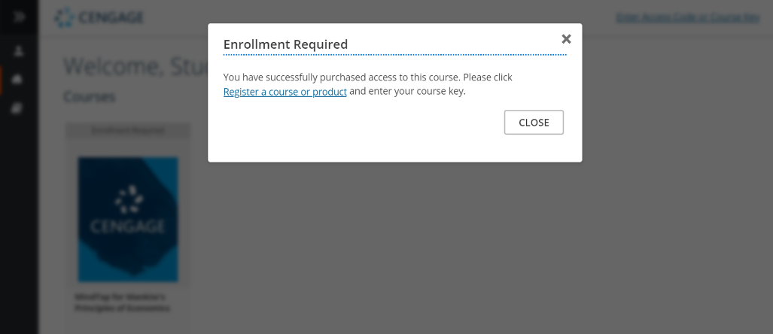
Enter Course Key
Under Enrollment Required, click “Register a course or product”.

Slide 12
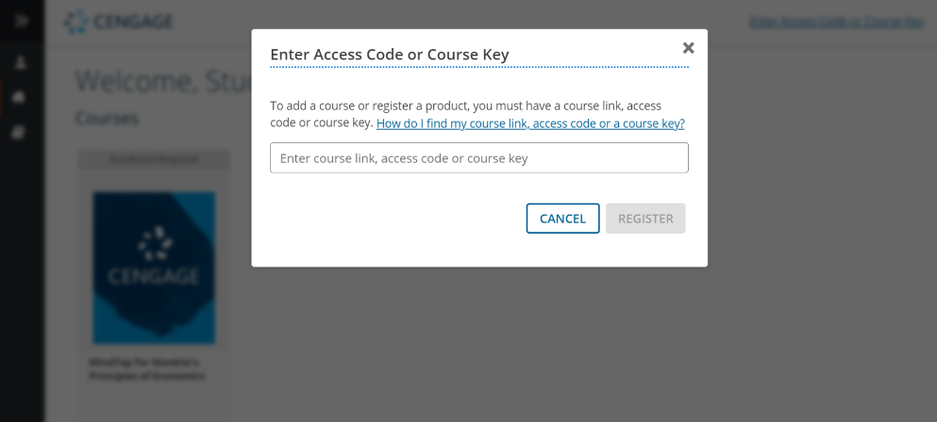
Enter Course Key
Enter the course key provided by your instructor. Click “REGISTER”.
MTPP-XXXXXXXX

Slide 13
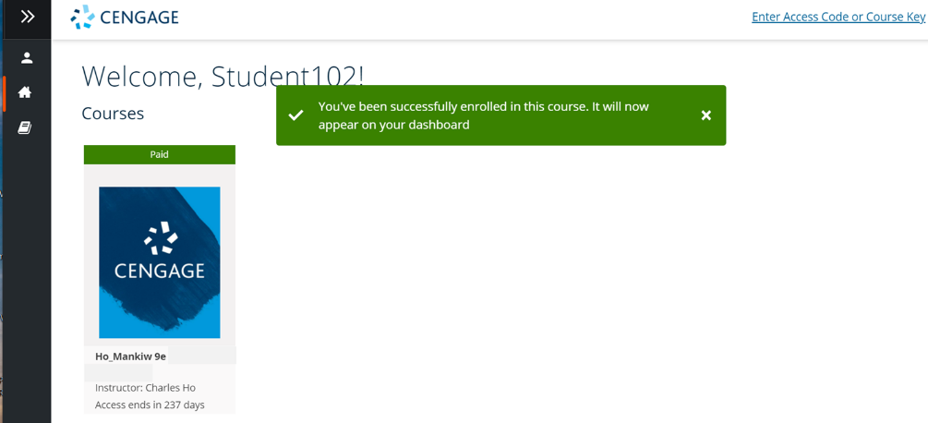
Access Your Course
You have successfully enrolled in this course. Click on it to open the course.

Slide 14
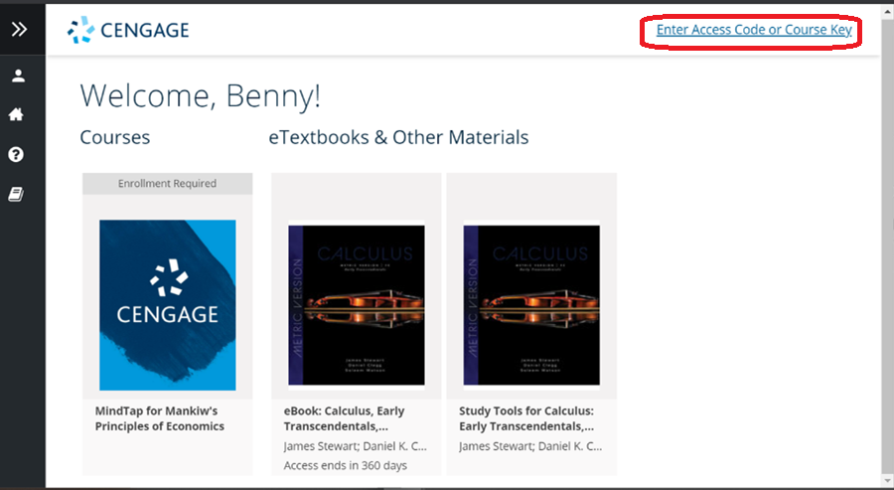
This is the homepage of your dashboard. You will find your courses, eTextbooks and other materials here.
Click on Enter Access Code or Course Key to add more products to your dashboard.

Slide 15
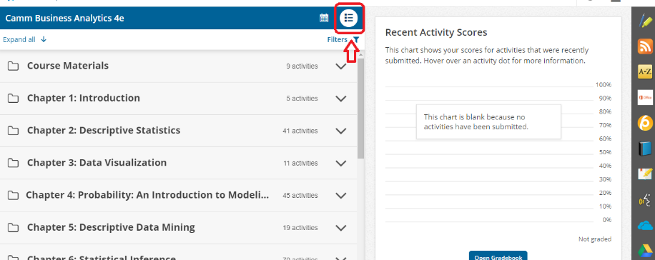
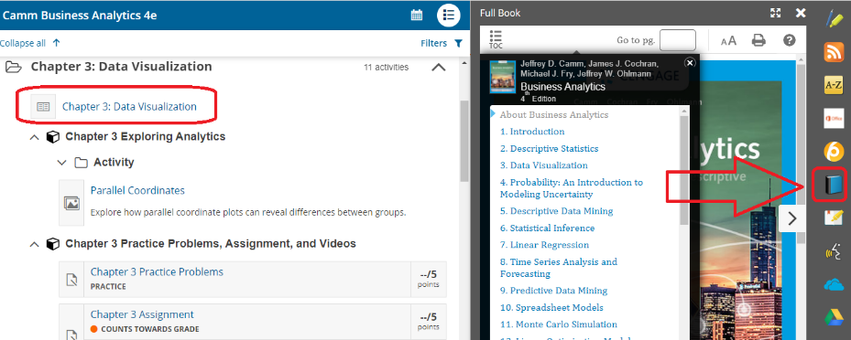
MindTap online resources –eBook
Expand learning activities folder on MindTap learning path and access
eBook and online resources
You can also access eBook through “ full book” app as well

Slide 16
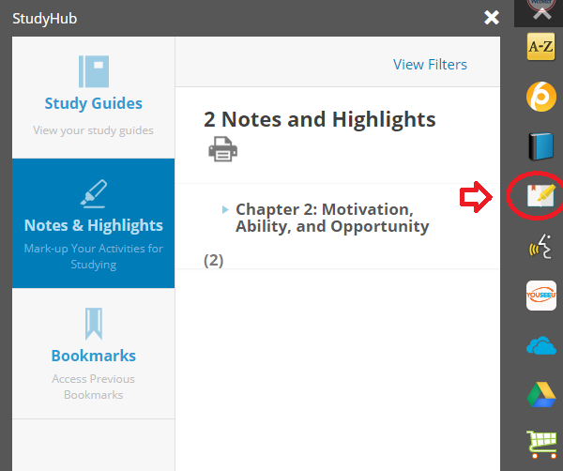
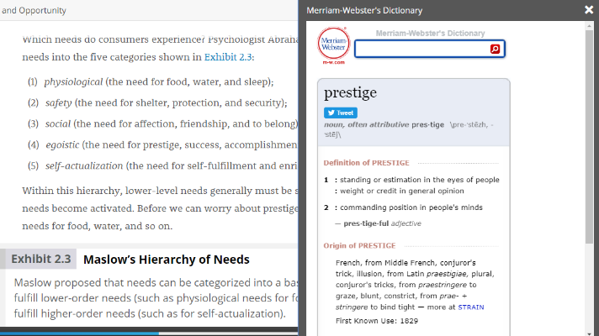
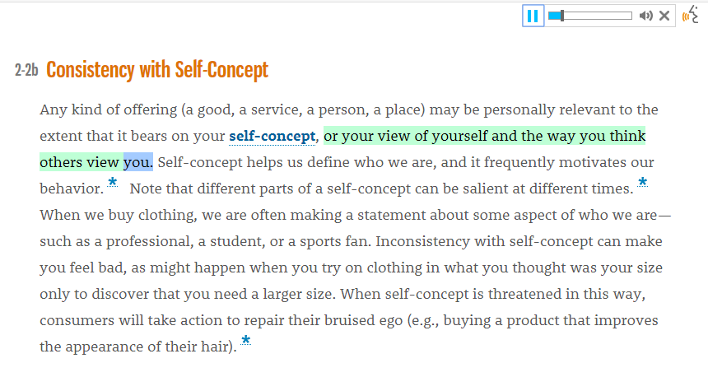
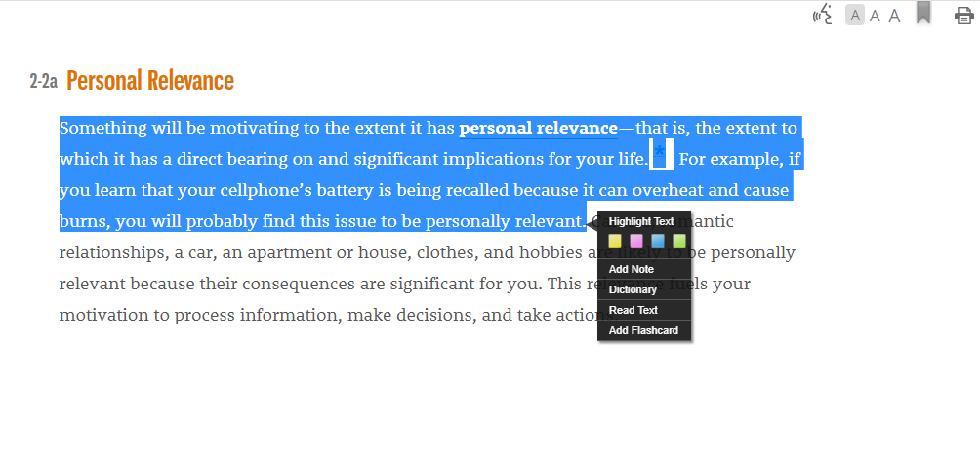
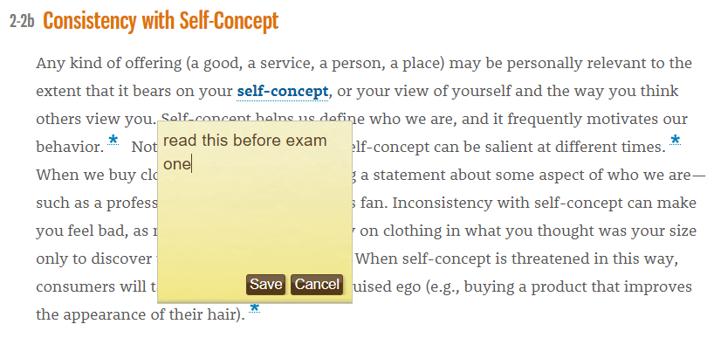
MindTap online resources –eBook
Learning Activities- Read Interactive eBook
- Explore the e-book. Highlight and take notes throughout the chapter to create a custom study guide accessible in the StudyHub app. ”

Slide 17
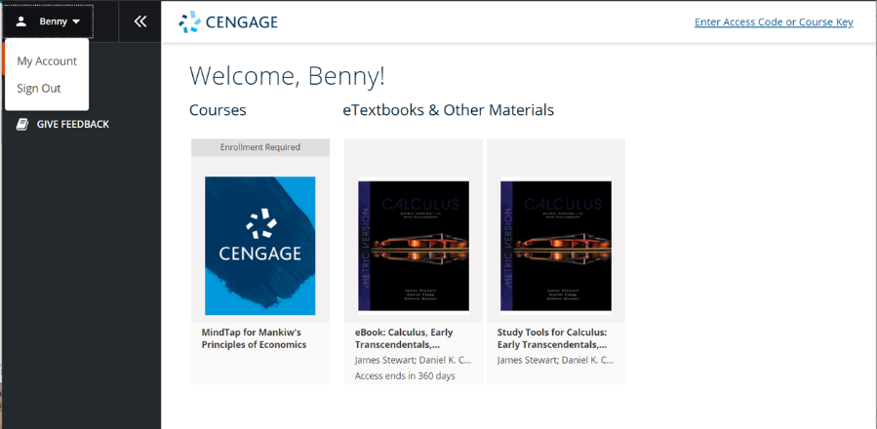
Sign Out
To sign out, open the User Menu and select Sign Out.

Slide 18







Get Mobile and Go!
Now that you’ve activated your courseware, you have free access to the Cengage Mobile App. With it, you get on-the-go access to:
Offline eTextbooks
Flashcards
Quizzes
Grades
And more!
Find it in the App Store or Google Play
Features Available for:
Note: Make sure you first access your courseware in a browser before accessing it in the app.
Notes:
OWLv2 has only ebook offline and study tools. No grades, polling, attendance

Slide 19



Have Questions? We’re Here to Help!
Real-Time System Status Updates
Visit techcheck.cengage.com to quickly see if Cengage is experiencing technical difficulties.
Online Self-Help
cengage.com/training
Tech Support Email
hk.hedtechsupport@cengage.com

